Slide 1
Php Session and Cookies
MS. Nabeela Bibi

Slide 2
How to create variables storing values across php scripts’ calls?
Client-server connection is not permanent
=> Cannot be saved in program memory
There are many clients connecting simultaneously
=> Cannot be saved in file (you cannot identify clients as well sometimes)

Slide 3
Different mechanisms of the same solution
Cookies
Cookies are a mechanism for storing data in the remote browser and thus tracking or identifying return users.
Sessions
Session support in PHP consists of a way to preserve certain data across subsequent accesses. This enables you to build more customized applications and increase the appeal of your web site.

Slide 4
What is a Cookie?
A cookie is a small file that the server embeds on the user's computer. Each time the same computer requests for a page with a browser, it will send the cookie too. With PHP, you can both create and retrieve cookie values.

Slide 5
How to Create a Cookie
The setcookie() function is used to create cookies.
Note: The setcookie() function must appear BEFORE the <html> tag.
setcookie(name, [value], [expire]);
This sets a cookie named "uname" - that expires after ten hours.
<?php setcookie("uname", $name, time()+36000); ?>
<html> <body> …

Slide 6
How to Retrieve a Cookie Value
To access a cookie you just refer to the cookie name as a variable or use $_COOKIE array
Tip: Use the isset() function to find out if a cookie has been set.
<html> <body>
<?php
if (isset($uname))
echo "Welcome " . $uname . "!<br />";
else
echo "You are not logged in!<br />"; ?>
</body> </html>

Slide 7
How to Delete a Cookie
It will expire
or
Cookies must be deleted with the same parameters as they were set with. If the value argument is an empty string (""), and all other arguments match a previous call to setcookie, then the cookie with the specified name will be deleted from the remote client.

Slide 8
What is a Session?
The session support allows you to register arbitrary numbers of variables to be preserved across requests.
A visitor accessing your web site is assigned an unique id, the so-called session id. This is either stored in a cookie on the user side or is propagated in the URL.

Slide 9
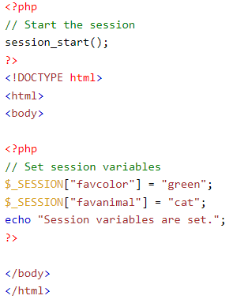
How to Create a Session
A session is started with the session_start() function.
Session variables are set with the PHP global variable: $_SESSION.
Note: The session_start() function must be the very first thing in your document. Before any HTML tags.

Slide 10
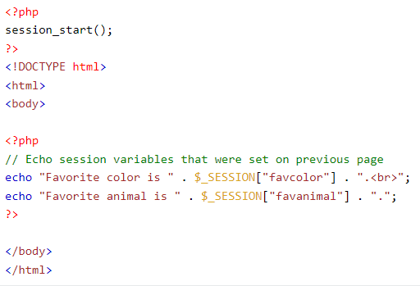
Get PHP Session Variable Values
session variables are not passed individually to each new page, instead they are retrieved from the session we open at the beginning of each page (session_start()).
Also notice that all session variable values are stored in the global $_SESSION variable:

Slide 11
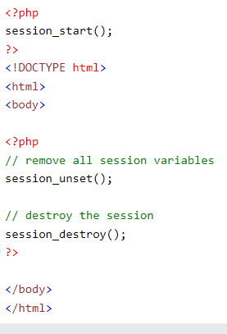
Destroy a PHP Session
To remove all global session variables and destroy the session, use session_unset() and session_destroy():

Slide 12
Cookie VS Session
Cookie | Session
Cookies are client-side files on a local computer that hold user information. | Sessions are server-side files that contain user data.
Cookies end on the lifetime set by the user. | When the user quits the browser or logs out of the programmed, the session is over.
It can only store a certain amount of info. | It can hold an indefinite quantity of data.
The browser’s cookies have a maximum capacity of 4 KB. | We can keep as much data as we like within a session, however there is a maximum memory restriction of 128 MB that a script may consume at one time.
Because cookies are kept on the local computer, we don’t need to run a function to start them | To begin the session, we must use the session start() method.
Cookies are not secured as stored data in text file. | Sessions are secured as save data in encrypted form.
We can set an expiration date to delete the cookies data. It will automatically delete the data at that specific time. | In PHP, to destroy or remove the data stored within a session, we can use the session_destroy() function, and to unset a specific variable, we can use the unset() function.

Slide 13
Thank you!

